Slide 1

CS-250 Software Development Lifecycle
Thomas Bartlett
August 11, 2022

Slide 2
Roles on a Scrum-Agile team
Product Owner
Responsible for Maximizing the value of the product and the work of the Development Team.
Scrum Master
Responsible for ensuring Scrum is understood and enacted by ensuring the Scrum Team sticks to the Scrum theory, practices, and rules.
Development Team
Consists of Testers and Developers that are self-organizing and cross-functional

Slide 3
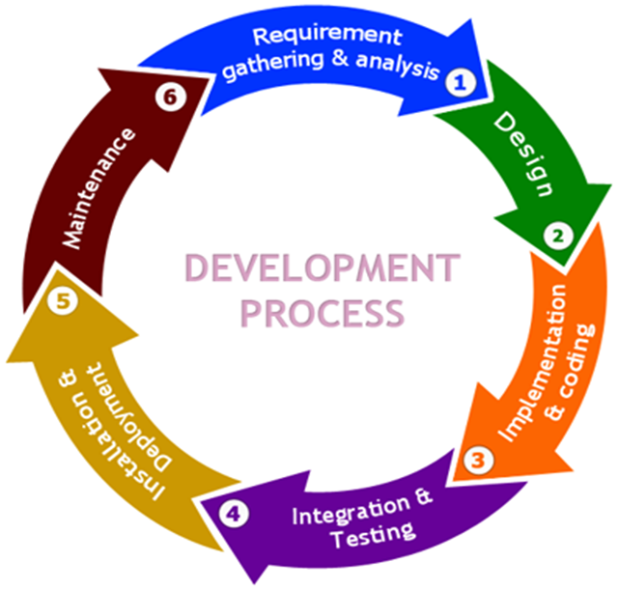
Phases of the software development Lifecycle
1. Analysis
Meet with client and stakeholders
Get essential requirements
2. Design
Discuss tools, practices, and frameworks to be used
Define essential functionality
3. Implementation
Break down requirements into increments to be completed
Code development
4. Testing
Identify bugs or defects
Perform integration and end-to-end testing
5. Deployment
The end product is delivered/deployed into a production environment
6. Maintenance
Maintain product functionality
Look for and document new features and bugs to be worked for in a later release
Notes:
Analysis – During this phase, the Product Owner meets with clients and stakeholders to determine and gather essential requirements.
Design – During this phase, some requirements are defined. The tools, practices and frameworks needed to successfully complete the project are discussed
Implementation – Requirements are broken down into increments so that development is done in phases. The product is developed and value is delivered at the end of each iteration.
Testing – Testing is done in all phases, however, this specific phase is used to identify bugs and defects to be worked in future iterations.
Deployment – During this phase, all testing is complete and the product is ready to be deployed for the client.
Maintenance – During this phase, functionality is monitored and maintained. Also, if new features are requested based on the final product, or bugs are discovered in the production environment, this is documented and worked in a later release.

Slide 4
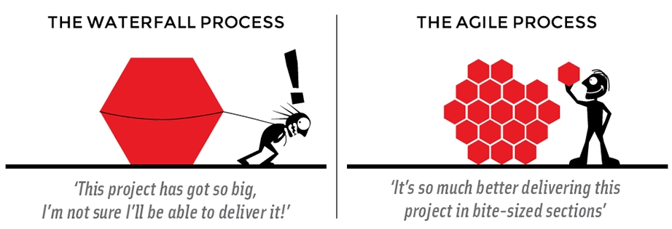
Agile vs. waterfall: snhu travel project
Waterfall:
All requirements must be defined upfront
Process is done in sequential stages
Agile:
Some requirements defined upfront
Process is done in incremental phases
Notes:
The biggest difference that would have occurred had we used the Waterfall methodology during the SNHU Travel project rather than Agile is the change that happened regarding the focus of the website would not have been allowed during the development of the product. Had Waterfall been in place, development would have been based on predefined requirements and if a change is requested and accepted, is only implemented after all stages of the Waterfall process have been completed.
Unless the project is small and straight forward, or needs to be clearly and strictly defined, I would choose to use an Agile approach to a project. When projects become large, and requirements are not always able to be well defined, using the Agile approach will provide the flexibility to change with needs of the project.

Slide 5
References
Charles G. Cobb. (2015). The Project Manager’s Guide to Mastering Agile : Principles and Practices for an Adaptive Approach. Wiley.
H. (2022a, July 29). Understanding the Phases of the Software Development Life Cycle. Harness.Io. Retrieved August 13, 2022, from https://harness.io/blog/software-development-life-cycle
Systems development lifecycle. (2019, March 7). [Illustration]. Imgbin.Com. https://imgbin.com/png/2u5JF7g4/systems-development-life-cycle-software-development-process-computer-software-png
Waterfall vs. Agile. (2016, November 24). [Illustration]. Blog.Ganttpro.Com. https://blog.ganttpro.com/en/waterfall-vs-agile-with-advantages-and-disadvantages/

